Slide 1
Games Bootcamp Challenge & Enemy AI

Slide 2
Recap
Advanced UI & UX

Slide 3
Table of contents
01
Creating Challenges
02
Enemy AI
03
Unity Navmesh

Slide 4
01
Creating Challenges

Slide 5
Types of Challenge
Cognitive
Coordination
Strategy
Test problem solving.
Puzzles, Riddles & Time-Based challenges
Test reflexes & timing
Combat, platforming, QTE
Long term planning.
Economy, skill points and enemy levels.

Slide 6
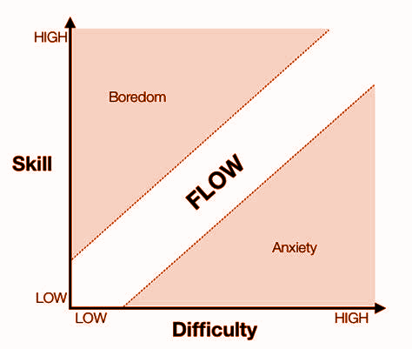
Balance
challenges should not bore the player because they're too easy, nor frustrate them because they're unfairly hard.
Gradual Progression:
Enemy & Player Leveling
Pacing
Skill Mastery:
Skill trees and corresponding challenges
Advanced mechanics/moves
Feedback Mechanisms:
Rewards / unique animations
Hints through dialogue or level design
Notes:
MENTION WEIRD PATHFINDING IN GAMES.

Slide 7
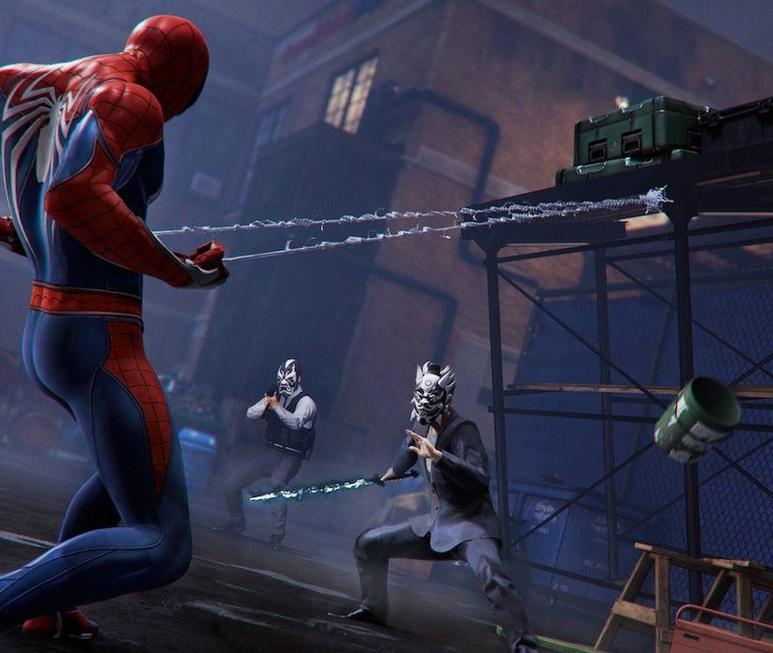
Variety
introduce new scenarios, mechanics, and challenges to ensure the gameplay remains fresh and engaging.
Alternating Challenge Types:
Break combat sequences with puzzles
Environment Dynamics
Environmental interactions
Traversal
New Tools and Skills:
Introduce new gadgets or enemies
Encourages player to adjust play-style
Notes:
MENTION WEIRD PATHFINDING IN GAMES.

Slide 8
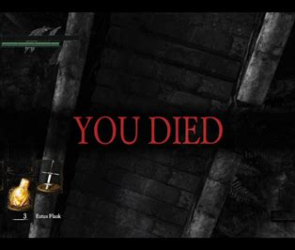
Fairness
Players should always feel that failures are due to their mistakes and not because the game is unfair.
Clear signposting:
Ensure players understand the objective
Introduce new enemies with a training scenario
Hint System
Offer hints on difficult sections
Adaptive Difficulty:
Quests recommended levels
Enemy scaling.
Notes:
MENTION WEIRD PATHFINDING IN GAMES.

Slide 9
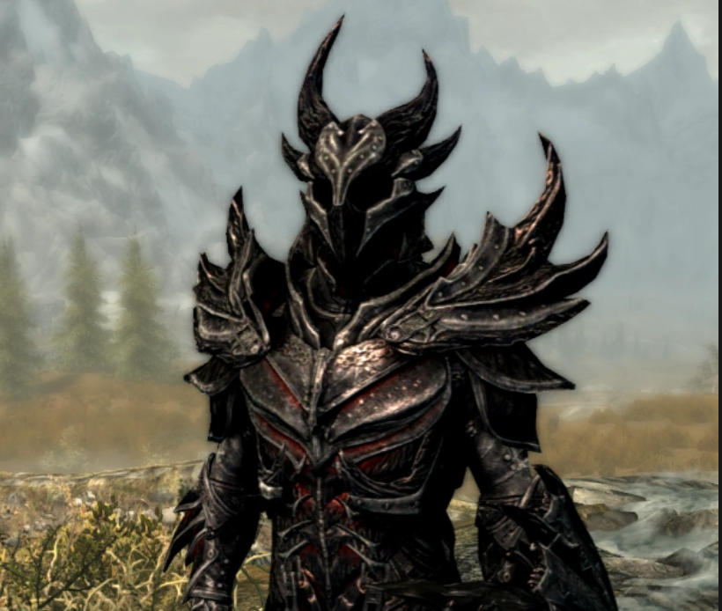
Challenge Through Game Elements
Game Economy
Serves as reward mechanism
Can be adjusted to tone of game
Boosts/Hints:
Frequency of health drops
Catch-Up mechanic in racing games
AI Behaviour:
Adjusting enemy vigilance
Morality and Decision Making
Making players face consequences
Moral decision making can be hard
Notes:
MENTION WEIRD PATHFINDING IN GAMES.

Slide 10
Dynamic Difficulty Adjustment
Automatically adjust the level of challenge in real-time based on a player's performance and behavior.
Data Driven/Skill Based:
AI Behavior: Adjust the behavior, accuracy, and strategy of AI-controlled entities (bots) based on player performance.
Skill-Based Matchmaking: In multiplayer settings, players are matched with opponents of similar skill levels by analyzing various metrics like win rate, kill-to-death ratio, etc.
Rubber Banding:
players who fall behind are given a speed boost or other advantages to keep the race competitive.
Leading players might face more challenges to prevent them from getting too far ahead.
Notes:
MENTION WEIRD PATHFINDING IN GAMES.

Slide 11
Task
Partner up
Explain the main type of challenge in your game
How will you balance the difficulty?
How will you add variety to the gameplay?
How will you ensure the game is fair?
Notes:
Quest level skulls

Slide 12
02
Enemy AI

Slide 13
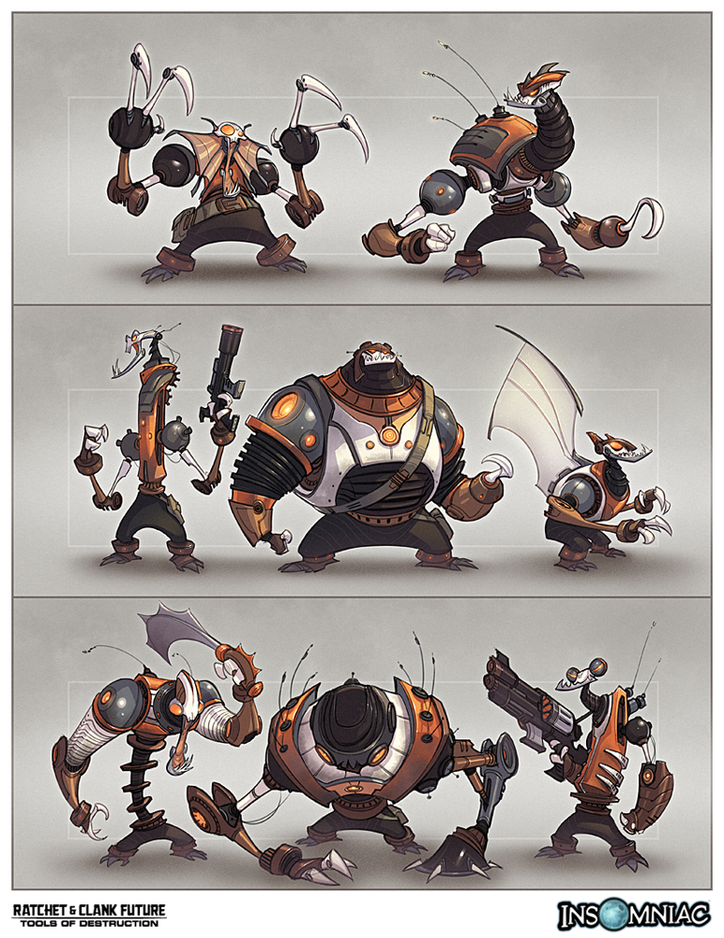
Enemies (1)
Enemies are a type of NPC that actively challenges the player.
All enemies have a programmed behaviour.
This is referred to as AI. (Not nearly as complicated as ML)

Slide 14
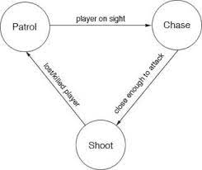
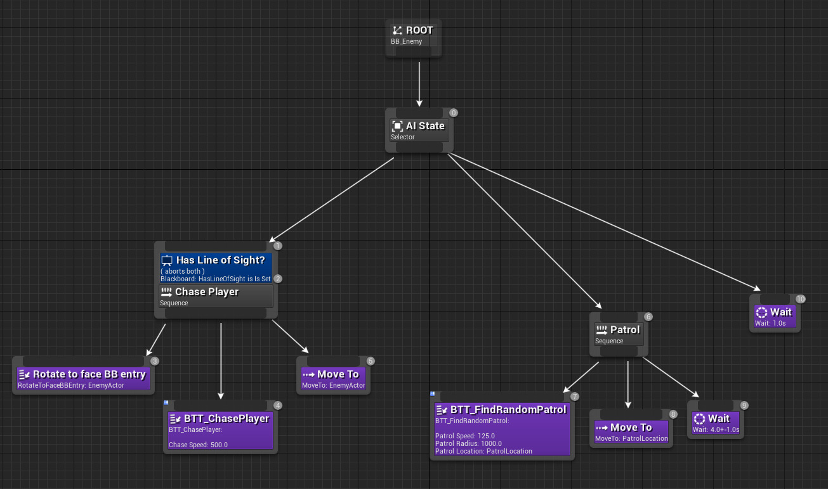
Enemies (2)
Finite-State Machine
Behaviour Trees
Advanced behaviours involve concepts like utility-optimisation or Goal-Oriented Planning. Most game approaches fall into 1 of 2 categories

Slide 15
Enemies (3)
A Behavioural Tree is a hierarchical structure that is traversed top-down in order to pick the best current action.
Trees are designed to be expandable
There are different nodes which control the flow of the tree.
Root Node: starting Point
Composite Node: controls flow
Sequence, Selector, Parallel
Decorator: Modifies the child nodes
Inverter, Failure, Repeater
Leaf Node: perform behaviours or actions
Notes:
There is a unity package but we will be making a basic solution to understand how the process would work.

Slide 16
Enemies (4)
A Finite-State Machine (FSM) is a way to abstract behaviours into different ‘states’. While they are much simpler and therefore predictable, they are harder to expand.
States: define a specific behaviour
Transitions: links the stages to one another.
Define what state can transition to another
Define a ‘rule’ that allows for the state change to occur.
Notes:
Demonstrate a simple Finite State Machine.

Slide 17
03
Navmesh

Slide 18
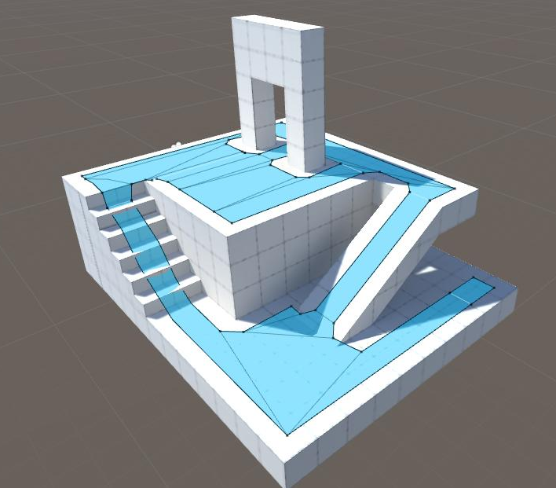
Navmesh (1)
For our simple FSM example, we have two states that require the player to move.
Navmesh is a built-in tool that allows us to define ‘Walkable’ surfaces.
Agents can then be defined that will be able to traverse this surfaces.
Consider your own player characters movement, if he is not on the NavMesh the agents will not be able to reach him
Notes:
MENTION WEIRD PATHFINDING IN GAMES.

Slide 19
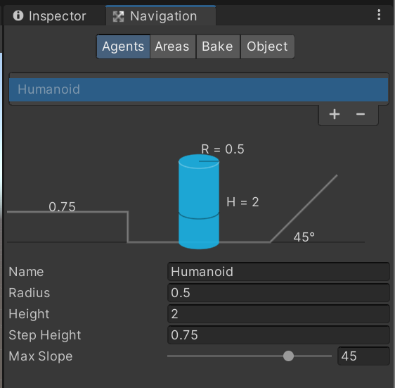
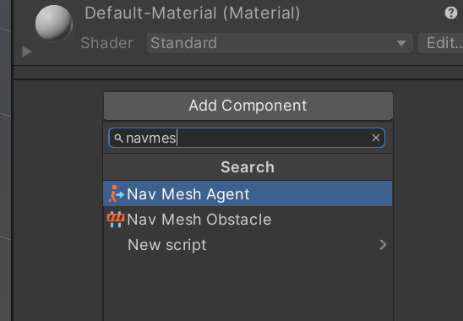
Navmesh (2)
The navigation window allows us to define limits for the NPCs
We can then ‘bake’ the navmesh into our level
Notes:
MENTION WEIRD PATHFINDING IN GAMES.

Slide 20
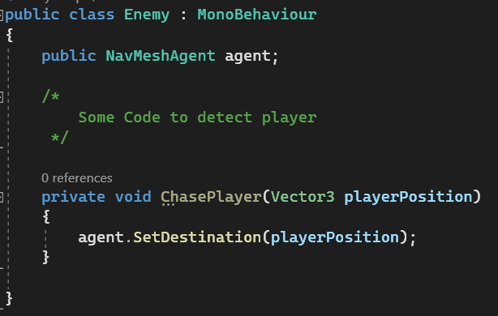
Navmesh (3)
With our NavMeshAgent component we can now set destinations for our NPC in a custom script.
Once a destination is set the agent will move to the position on the NavMesh that is closest to the target position.
Notes:
MENTION WEIRD PATHFINDING IN GAMES.

Slide 21
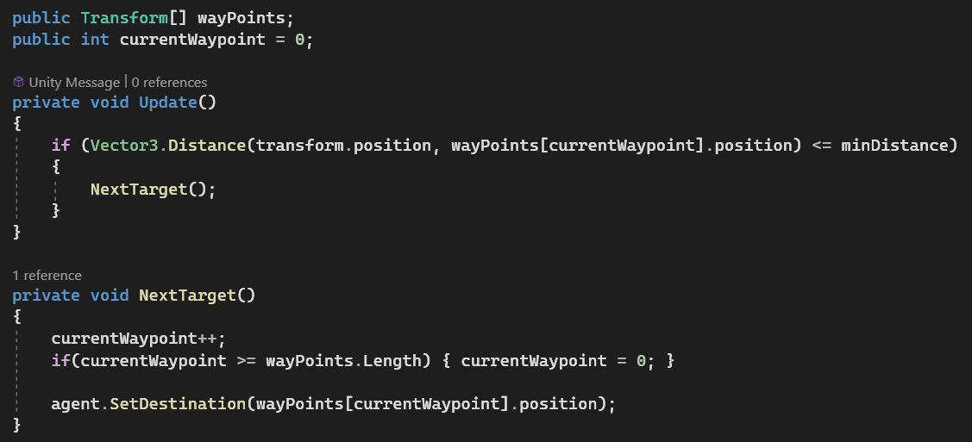
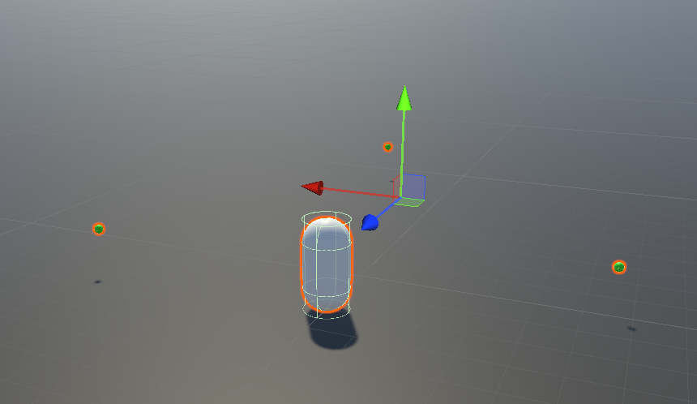
Navmesh (4)
We can define a ‘patrol’ route with waypoints. (Empty GameObjects)
We can then check if the agent has reached the current target and switch to the next one.
You may want to consider ‘waiting’ at each waypoint before continuing
Notes:
MENTION WEIRD PATHFINDING IN GAMES.

Slide 22
Thanks!

